Slide 1
Designing Intelligent Agents: Coursework Advice
Colin Johnson

Slide 2
Two Versions of the Coursework depending on Module
COMP3004 (primarily undergraduate version)
A detailed description of your project work; one of:
a report of 2500-4000 words
a 20-minute video
A 20-minute audio podcast
Your code (files or link to repo, e.g. git)
Anything else relevant—perhaps example outputs from your system, extended design documents, results, etc. (but, bear in mind that these need to be markable).
COMP4105 (primarily postgraduate version)
All of the above…
… plus a 10-minute presentation
Notes:
If it goes over these limits by a little, it doesn’t matter too much

Slide 3
Coursework: Four Main Components
An autonomous intelligent agent
…acting in some kind of environment
…about which you ask a scientific or technical question (or, set of related questions)
…and which you evaluate using a set of structured, rigorous experiments

Slide 4

Autonomous Intelligent Agent
An autonomous intelligent agent is a computer system that takes in information, uses some kind of AI to process it, and then selects some kind of action that changes the environment
Often, there is:
a loop by which this change to the environment prompts the next set of inputs
multiple interacting agents giving rise to emergent behaviour
So, not just something that learns into something static like a set of labels

Slide 5
…to Answer a Scientific or Technical Question
How do different approaches (a genetic algorithm, an A* search algorithm, a hard-coded heuristic) compare in terms of task performance?
How does the performance of the system change as we vary the number of agents in it?
If the system is trained on one version of the environment, does that learning transfer over to a new version of the environment
How do different kinds of communication/coordination between agents effect the efficiency of those agents on the task
How much improvement does storing some information (e.g. a map of the environment) make compared to carrying out the task in a purely reactive way?
How do different kinds of sensing/perception systems affect the capacity of the agent to carry out its task?
How sensitive is the agent to error/noise?
…

Slide 6
…in an Environment
The agent gets information by perceiving its environment, and its actions change the environment.
A simulation of a physical environment in which mobile robotic agents move. This could be the simulation used in the classes earlier in the semester (perhaps extended), a robot environment such as The Player Project (http://playerstage.sourceforge.net), or a project in Unity or a similar game environment if you are familiar with one from elsewhere.
A chatbot environment such as the ones used in the classes
The blackboard system used in the class where we discussed language agents writing poetry
The Bristol Stock Exchange system introduced in the classes later in the semester (https://github.com/davecliff/BristolStockExchange) or a similar simulation of some aspect of the economy or society
A game environment such as Ms. PacMan (https://gym.openai.com/envs/MsPacman-v0/), the Open Racing Car Simulator (http://torcs.sourceforge.net), RoboCup (https://www.robocup.org/leagues/23) or similar (see e.g. http://www.gvgai.net)
One of the more complex task environments from the OpenAI Gym (https://gym.openai.com)
…or something else that you find or build or extend.

Slide 7
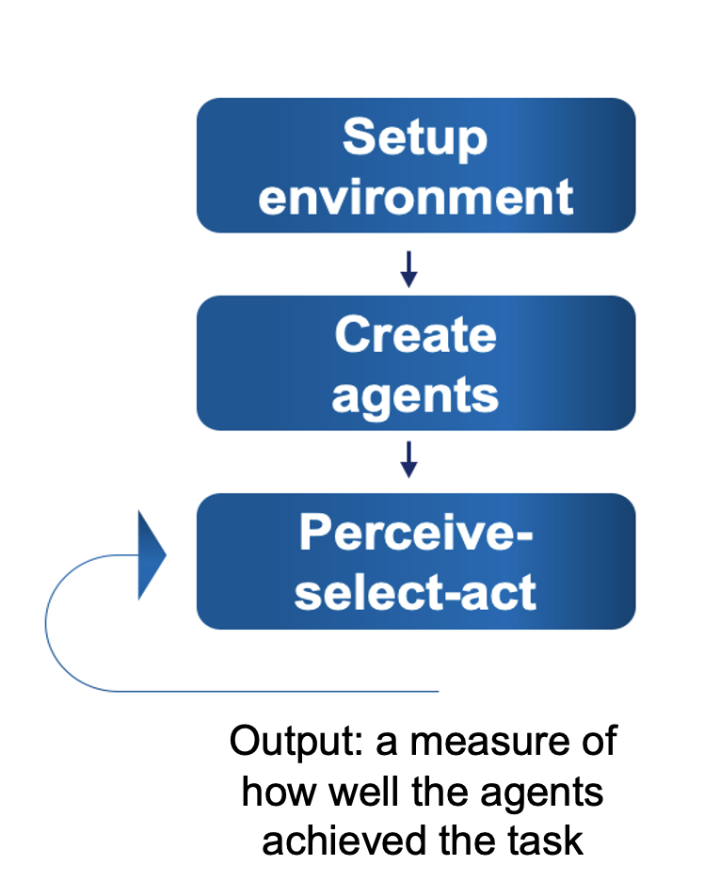
…and which Analyses that Question Rigorously using Experiments
Conclusion
Visualise and Analyse Results
Visualisation
Descriptive statistics
Inferential statistics
Run All Experiments
Setup Parameters and run Experiments
Setup Parameters and run Experiments

Slide 8
Contents of your Report/Video/Podcast
The core ideas of your project; clearly state the question that you are trying to answer
A review of relevant ideas, technologies and research papers
you should mention at least 2-3 papers, books, pieces of software, technologies, etc.—more if you want to!
How you designed the environment and agents in order to address that question
Technologies used, and challenges that you met in doing the implementation
How you set up and ran your experiments
The results from your experiments
A discussion of the question in light of the experimental results
A conclusion, where you summarise the work, reflect on its successes and limitations, and briefly mention some ideas for how you would take the work forward if you had more time

Slide 9
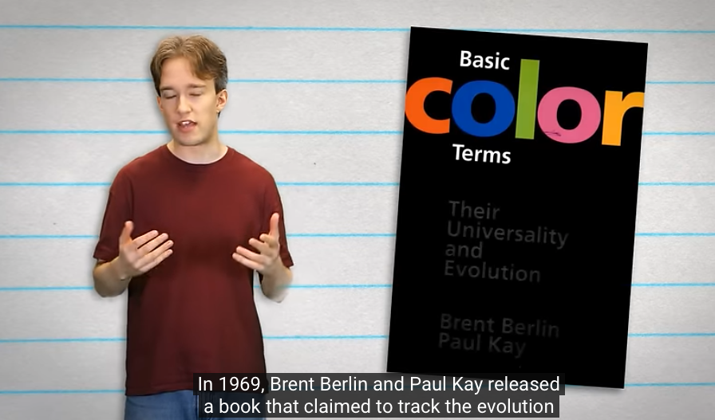
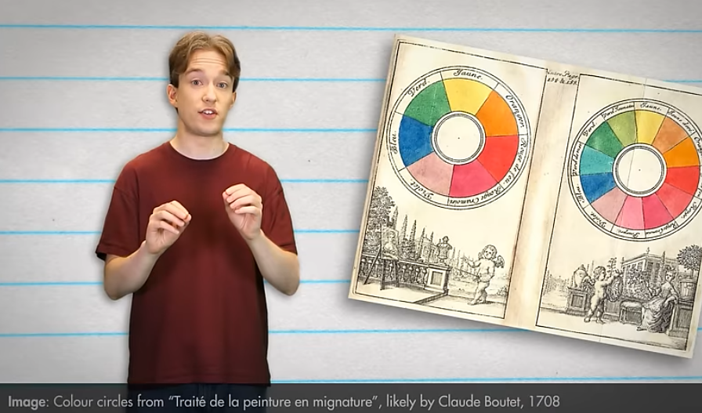
Review and Context
You should put your paper into context, by mentioning other work that is relevant:
software libraries
research articles
textbooks
online lectures
…
For the purpose of this assessment, a wide variety of sources are acceptable…you don't have to restrict yourself to peer-reviewed scientific literature
Be consistent with referencing; any style is acceptable, but stick to it
For videos, use e.g. text footnote for references, image of book, or reference slide at the end)
For podcast, perhaps full references at the end or in notes

Slide 10
In what way can some work be relevant?
You might have built on it in some way: using an software, adapting and implementing an idea, using some analysis technique
You might contrast your work with it: I did this, here are some research results from another group, here is how the two things differ…
You might have gotten the initial idea from it: here is a well-known problem, I'm tackling it in this way…
You might have got some resource from it, e.g. a dataset.

Slide 11
Design and Implementation
Say what you did—and why!
If you used existing software, make it clear what is your work
in your report
and in comments in your code
Try to give a broad overview of the design of your agents/environment.
Why were they designed in this way? What were the alternatives?
How does this design help us to answer the question that you have chosen?
Talk about specific implementation challenges, if relevant
…but don't give a line-by-line account of the implementation

Slide 12
"Added Value"
You should explain how your work "adds value" to existing work
This could be:
how you have added features to the agent or environment
how you have used existing software/ideas/resources to ask interesting questions
how you have analysed and evaluated your work
Your work
This difference doesn't matter
Your work
Existing work
This does!
Existing work

Slide 13
Evaluation
Evaluation could be through qualitative features:
accuracy
speed
task success
…by detailed examples
e.g. you might animate a robot navigating through an environment, and then include that video or a screenshot in your submission and discuss specific features
…or through qualitative aspects:
asking people to use your system and getting them to comment on it
you don't have to ask them to judge their interaction...you could gather an account of their interactions, and present the themes that come through in that account

Slide 14
Experiments
How did you set up your experiments?
How did you automate this (where relevant)?
Often, your question will be about contrasts:
what happens if I vary some parameters?
what is the difference between these two (or more) scenarios?
…if so, how did you choose which parameters to change, which scenarios to use? How does this relate to your question?

Slide 15
Results
Clear presentation of results:
quantitative: charts, tables
qualitative: themes, illustrative quotations
If your agent behaviour has some randomness, make sure that your results demonstrate multiple runs
…summarised e.g. by mean and standard deviation
One experiment, one chart/table
don't make it over-complicated
…plus, perhaps, a summary of multiple experiments

Slide 16
Discussion and Conclusion
Don't just present the results and then…done!
Return to the question…give an honest and evidence-based answer to the question using the results
It doesn't matter whether the question is answered "positively", give a clear and nuanced view of what your results say about the question
Try to come to some conclusion…even if that conclusion is that more work is needed to clarify some of the points that have arisen in the work
…regardless, you should include some brief ideas for next steps…if you had had a few more weeks, what would you have done?

Slide 17
How not to do a good report/video/podcast
Disorganisation—skipping from topic-to-topic in an arbitrary way
Not justifying what you have done
Not giving credit to the work that you have built on
…at worst, this spills over into plagiarism
Just focusing on the coding, not on the question(s), experiments and context
Not coming to some conclusion at the end

Slide 18
Key ideas
Make sure that you explain why, not just say what
Remain focused on the question(s) that you are asking in your project

Slide 19
Presentation (COMP4105 only)
A short presentation—10 minutes
yes, really, 10 minutes is short
Suggested structure
Intro to the environment and agents (1-2 slides)
Question you are asking (1 slide)
Background—papers you have read and why they are relevant (1 slide)
What have you implemented (1 slide)
What experiments have you done (1 slide)
What are the results (1 slide)
What can be concluded from those results (1 slide)
(perhaps) wider implications and what questions do this lead onto (1 slide)
Presentation sign-up will shortly be available on Moodle
presentation slots will be available from 14th May onwards

Slide 20
How the Coursework will be Assessed
background research and how you have used it to contextualise your work
the choice of task environment and how you have used it/adapted it for your specific project
the effective use of artificial intelligence and agent-based systems ideas from the course and your wider studies in designing your autonomous agents
how clear your question(s) are, how well the experiments have been designed to answer them, and your level of rigour in planning and analysing the experiments
how well the report answers the question by using the evidence from the experiments
the overall clarity and structure of the report, appropriate use of scientific and technical English, and the quality of charts, diagrams, pseudocode where relevant
the quality of reflection on the successes and limitations of the work
(for students doing a presentation) the structure of the presentation, the clarity of explanations, and good use of slides or other visual aids

Slide 21
Any questions?

